Slide 1
ITI GRADUATION PROJECT
PRESENTED TO :ENG AHMAD SAEED - ENG MOSTAFA ASHRAF
SMART HOME PROJECT
By : Omar Alaa

Slide 2
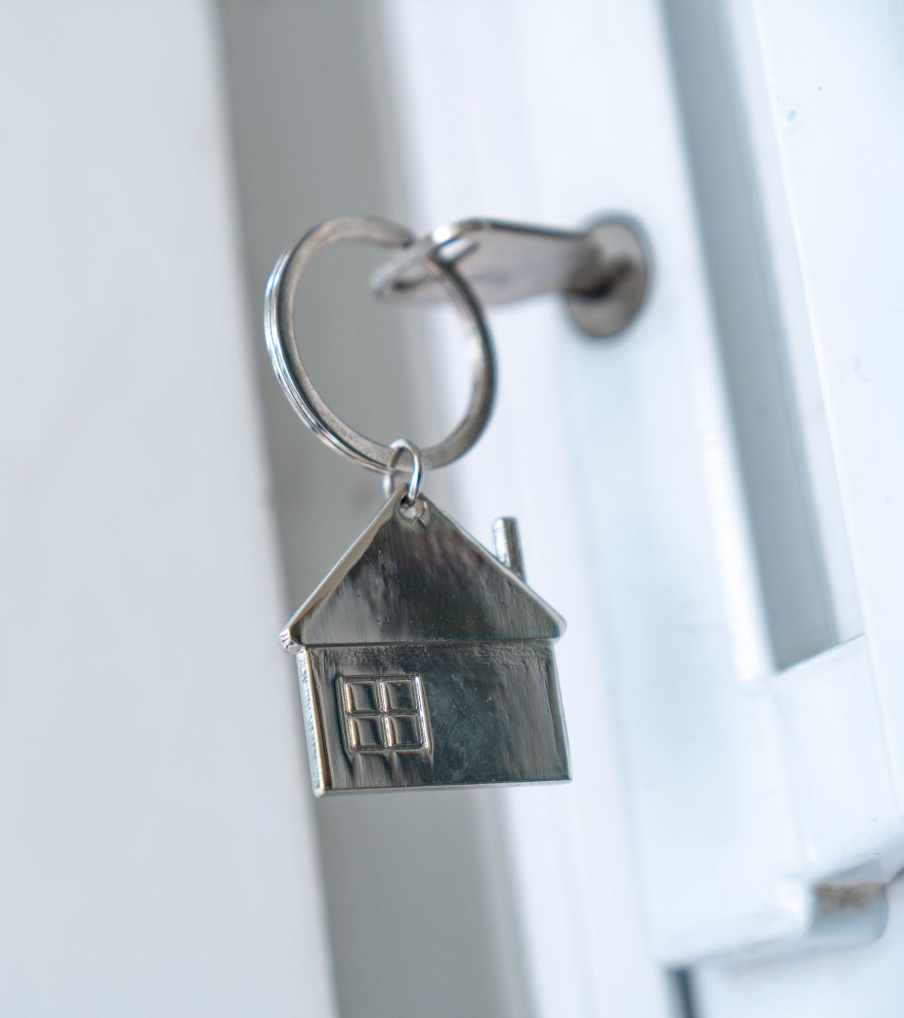
SMART HOME FEATURES
Password Lock System
USART Communication
Buzzer Alert

Slide 3
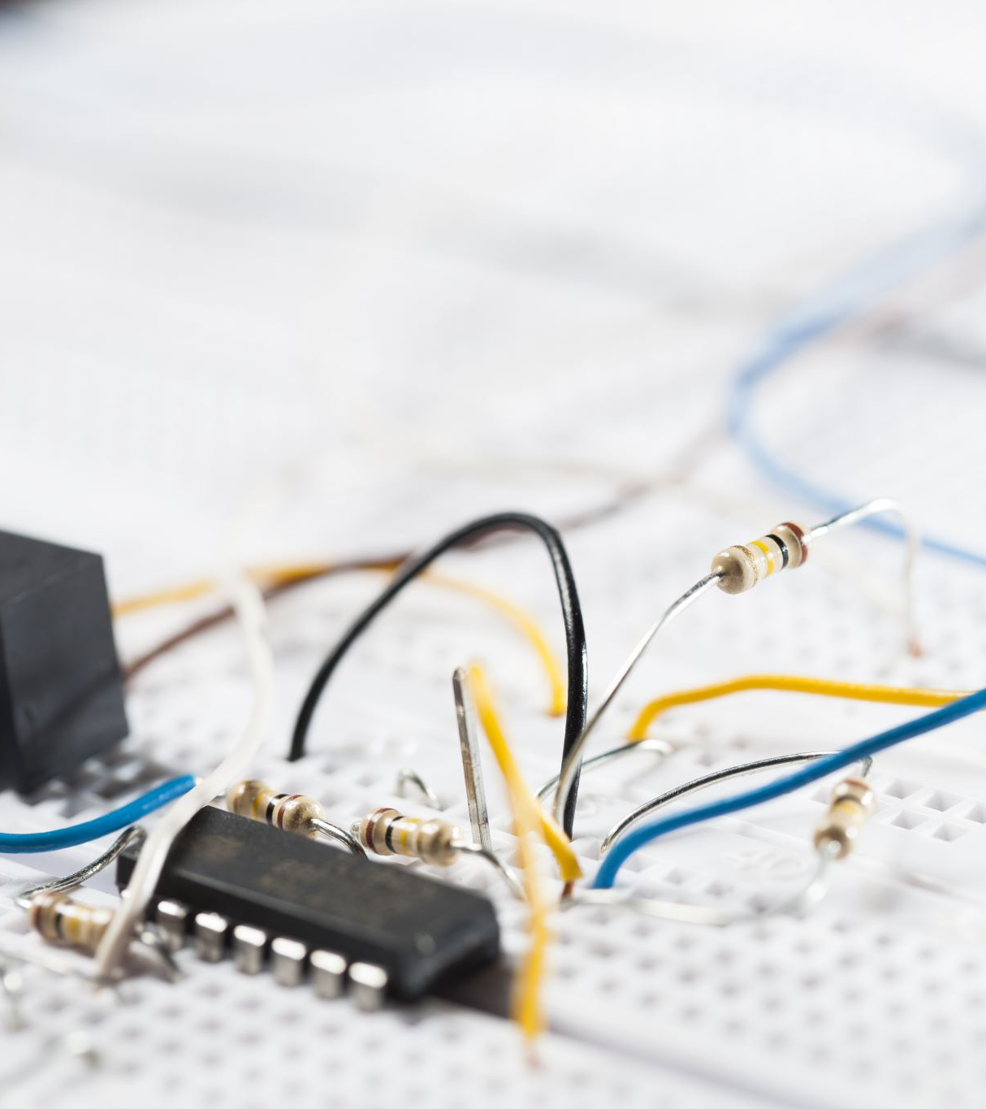
Components
ARM Cortex M4
HC-05
DC Motor
Motor Driver
Leds
Buzzer

Slide 4
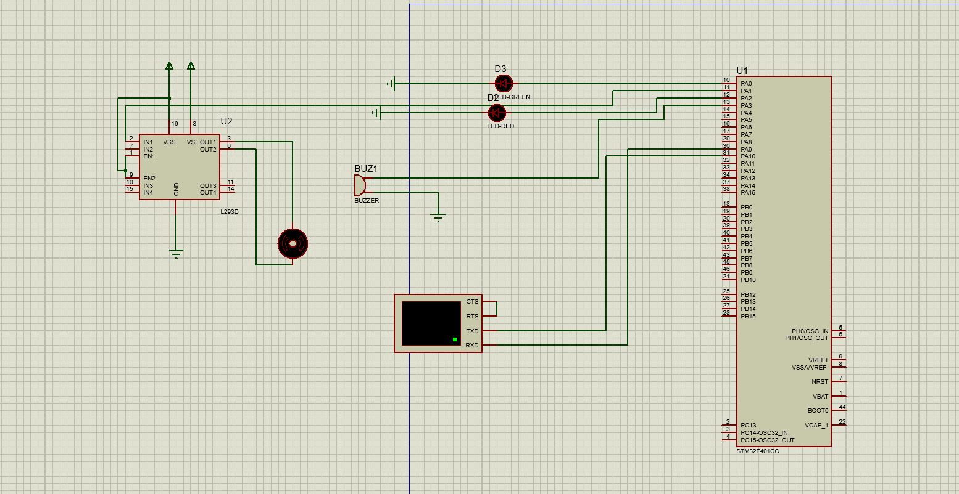

Slide 5
Static Architecture
SMART HOME APPLICATION
LIB
HAL LAYER
MOTOR LED BUZZER HC-05
STD_TYPES
BIT MATHS
DELAY
MCAL LAYER
RCC GPIO USART

Slide 6
Problems && Solutions
Problems | Solutions
Set Password only before run time | Usage of EEPROM
HC – 05 not available | Usage of Visual Terminal
Communication between User and HC-05 can be easily hacked | Usage of Keypad and LCD

Slide 7
Next Features
Voice Control such as AC ON or Led ON or OFF
Also control led intensity Using PWM and USART

Slide 8

THANK YOU

